Slide 1
Unsupervised Clustering of Human Tissue Samples Based on Gene Expression Profiles
Varun Gupta, Uday Kiran Gogineni,
Niteesha Adapala

Slide 2
Data Preprocessing and Normalization
Bulk RNA-Seq data was downloaded from GTEx (https://gtexportal.org/home/downloads/adult-gtex/bulk_tissue_expression).
We used TPM-normalized matrix that contained ~ 59,035 genes and 19,616 tissue samples.
We calculated the rowMeans for each gene and filtered out genes with exp > 1 tpm.
With the above parameters, we are left with 20,545 genes.
If any missing values (none seen though) was present, we removed the gene itself.

Slide 3
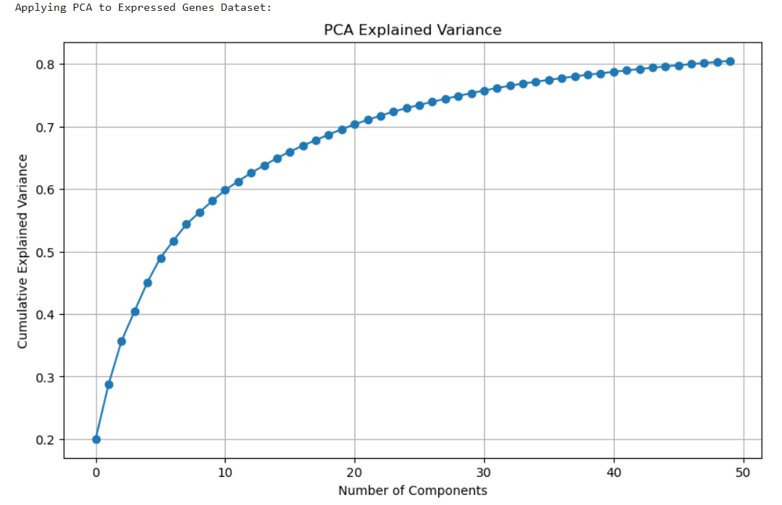
Dimensionality Reduction: PCA
PCA-projected features were the basis for clustering, enabling tractable, noise-reduced analysis.
First 5 components explain 45.10% of variance
First 10 components explain 60% of variance.
First 50 PC components explain 80% of the data variance.

Slide 4
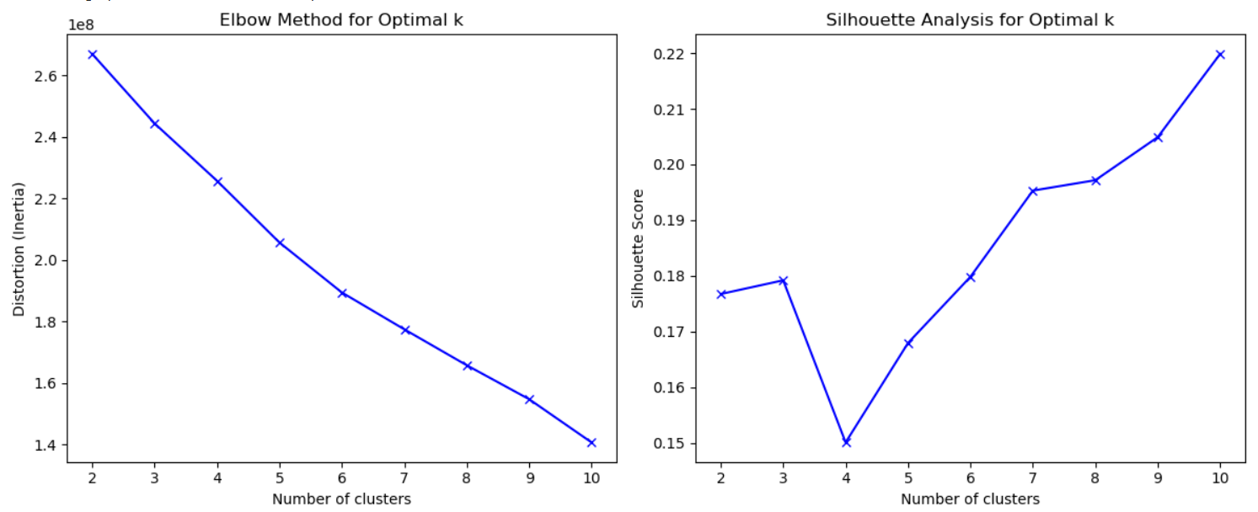
Elbow Plot and Silhouette Analysis

Slide 5
Clustering Approaches & Performance

Slide 6
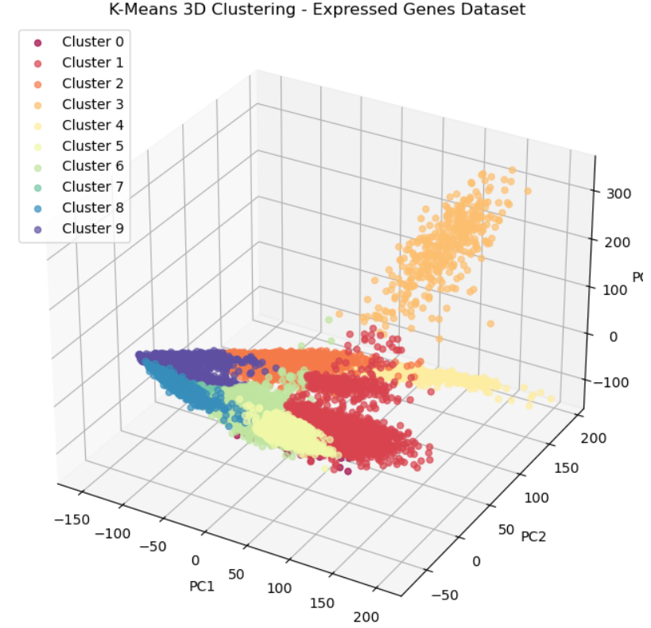
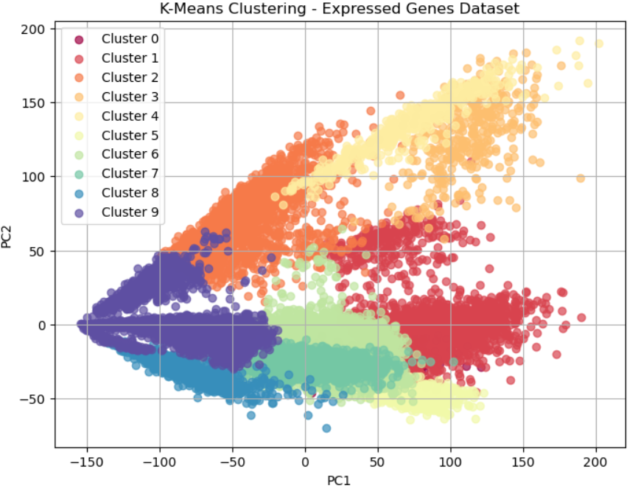
K-Means: Baseline Clustering Performance
K-Means Evaluation, it balances between interpretability and performance:
Silhouette Score: 0.243 (Higher is better, range [-1,1])
Calinski-Harabasz Index: 2842.1 (Higher is better)
Davies-Bouldin Index: 1.438 (Lower is better)

Slide 7
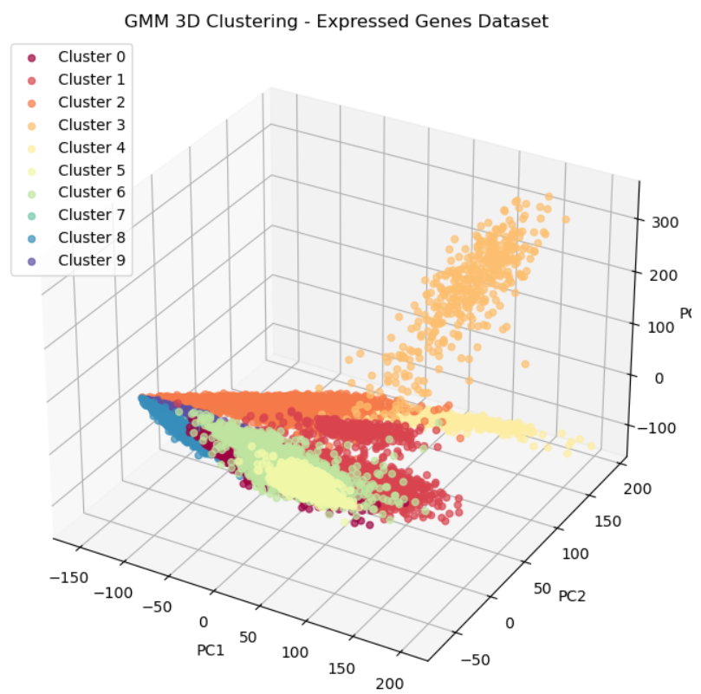
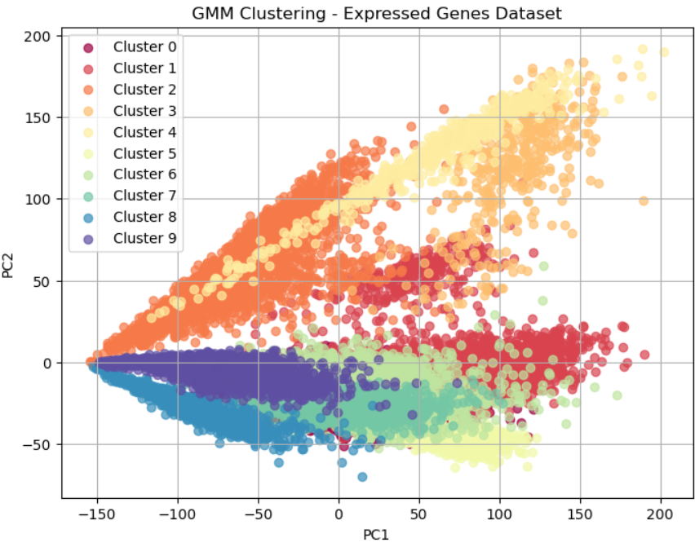
Gaussian Mixture Models (GMM)
GMM Evaluation:
Silhouette Score: 0.201 (Higher is better, range [-1,1])
Calinski-Harabasz Index: 2474.9 (Higher is better)
Davies-Bouldin Index: 1.801 (Lower is better)
Performed reliably across the full dataset, balancing interpretability and clustering quality

Slide 8
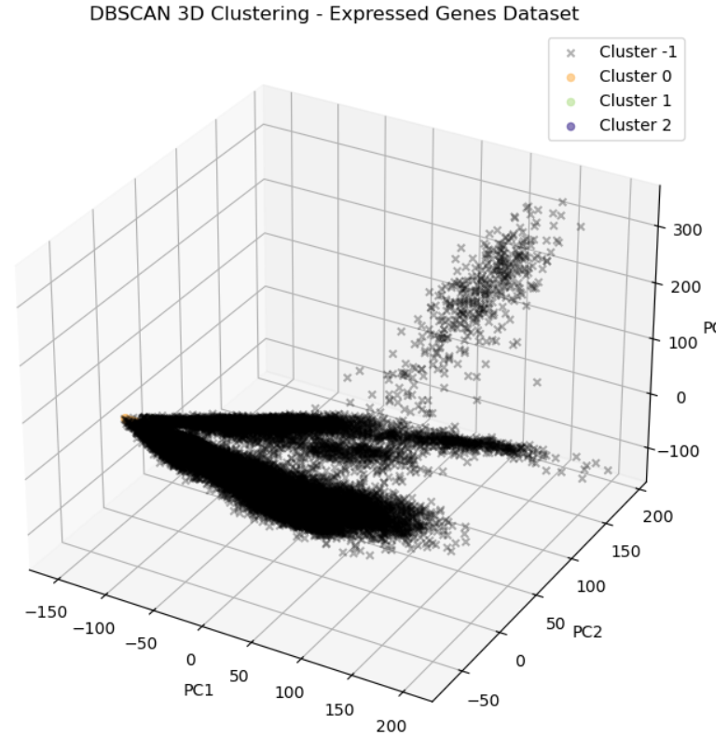
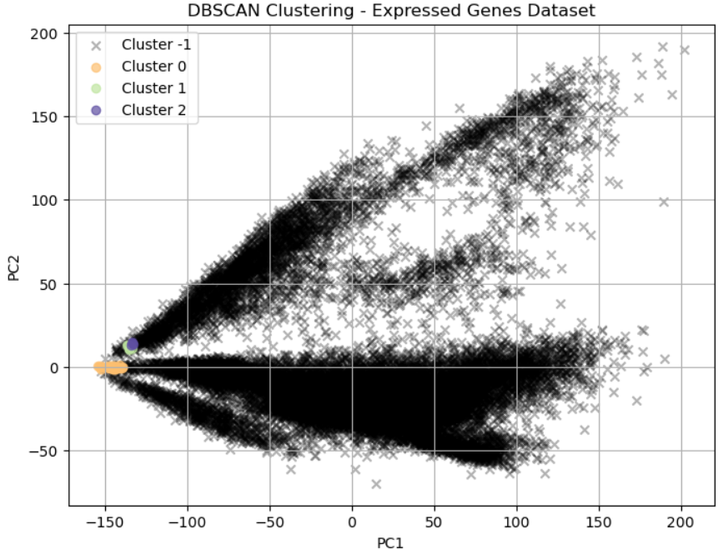
DBSCAN: Density-Based Clustering and Noise Detection
DBSCAN (core points only) Evaluation:
Silhouette Score: 0.660 (Higher is better, range [-1,1])
Calinski-Harabasz Index: 136.6 (Higher is better)
Davies-Bouldin Index: 0.877 (Lower is better)
Excelled in forming high-quality clusters for the subset of core points, showing true biological patterns

Slide 9
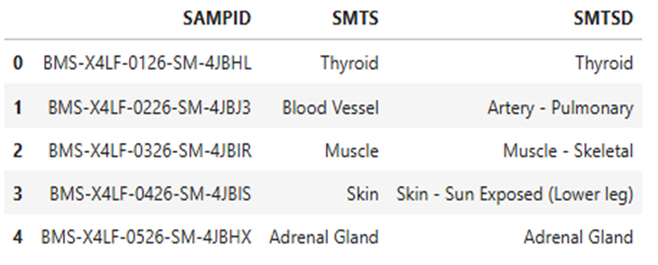
External Validation Against Known Tissue Labels
Metadata loaded: ( rows : 48231, columns : 119): This was taken from the GTEx website “GTEx_Analysis_v10_Annotations_SampleAttributesDS.txt” and Sample of MetaData
SAMPID is Unique sample ID from the GTEx dataset
SMTS is Broad tissue type
SMTSD is detailed tissue description
Comparing our clusters to known tissue labels and the score were:
Adjusted Rand Index (ARI): 0.191 : Some alignment with real tissue classes (modest agreement).
Normalized Mutual Information (NMI): 0.571 : Moderate-to-good alignment, indicating meaningful grouping.

Slide 10
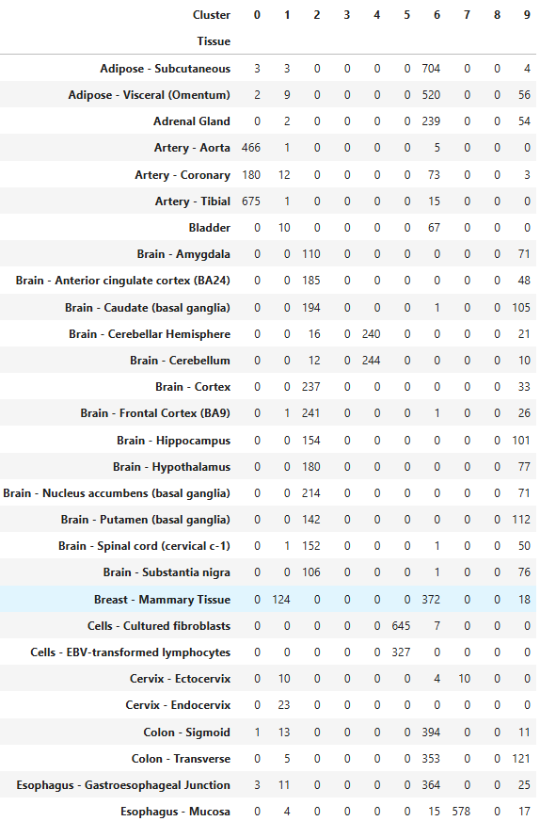
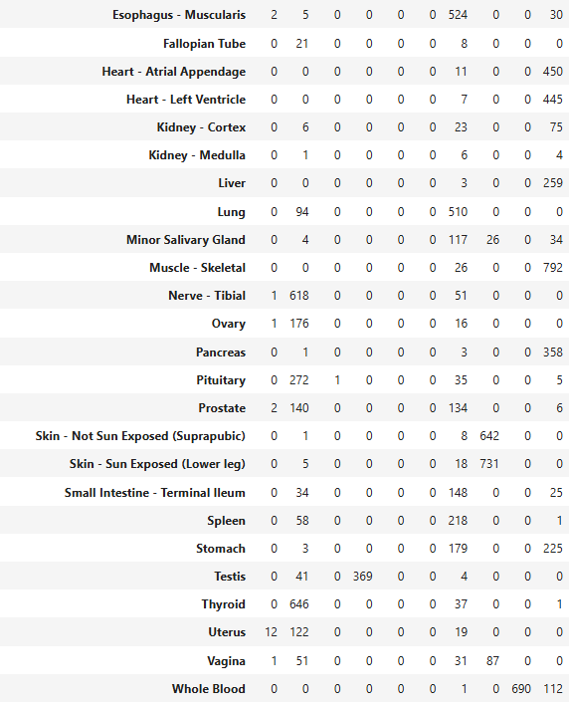
Cluster
Purity
The matrix uses metadata to measure how good the clustering was.

Slide 11
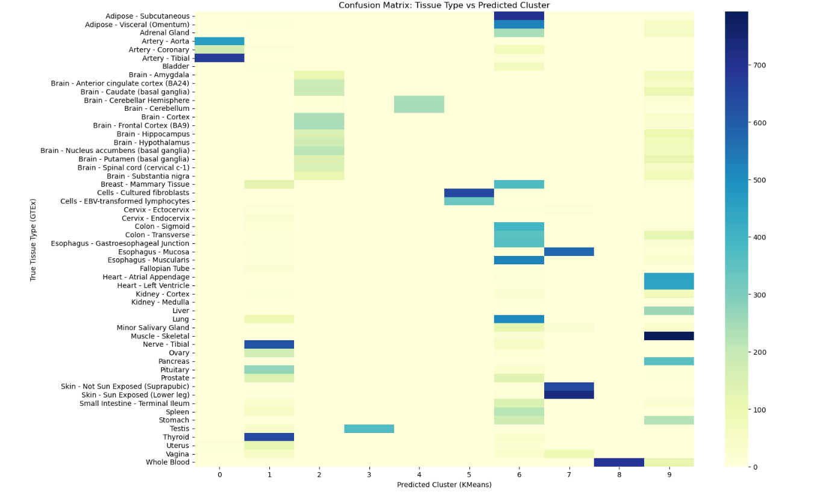
Confusion Matrix
This shows that brighter/darker the cell is, the more samples fall into that tissue-cluster pair.

Slide 12
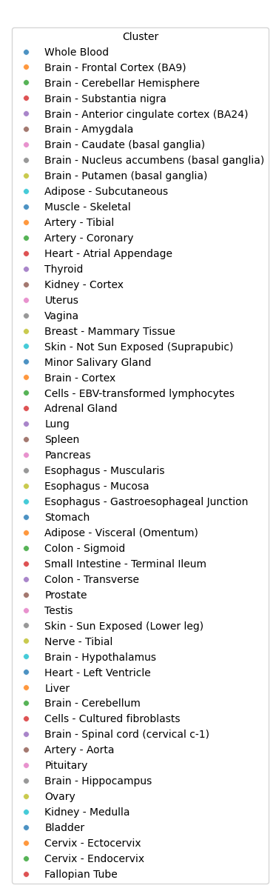
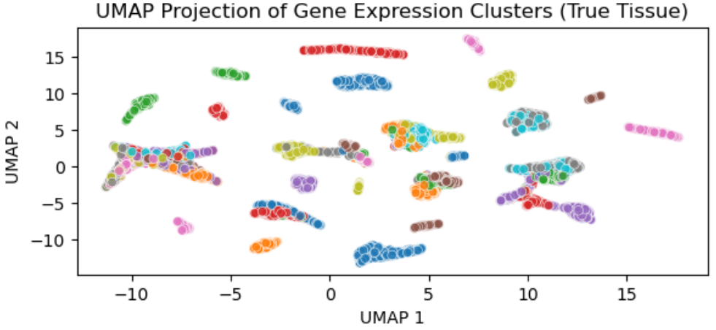
UMAP Visualization Analysis- Tissue-Level Gene Expression Clusters
The UMAP (Uniform Manifold Approximation and Projection) plot shows a 2D embedding of gene expression data from the GTEx project.
Each point represents an individual sample, colored by its annotated tissue of origin.
The plot demonstrates clear spatial separation between many tissue types, affirming the utility of UMAP in revealing latent biological structure.

Slide 13
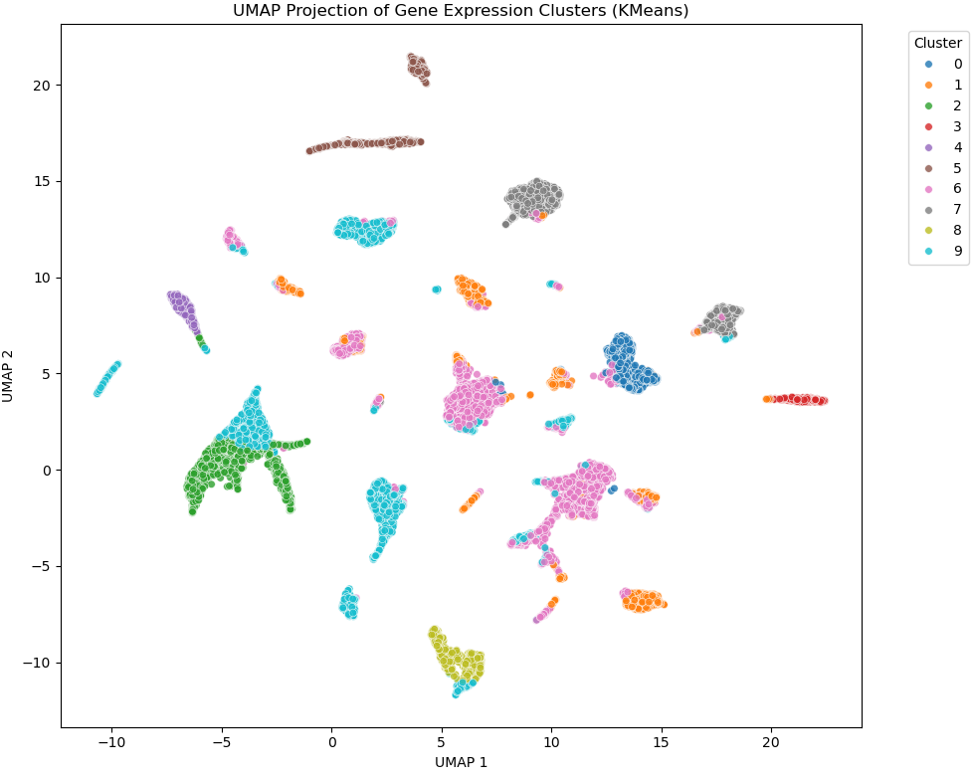
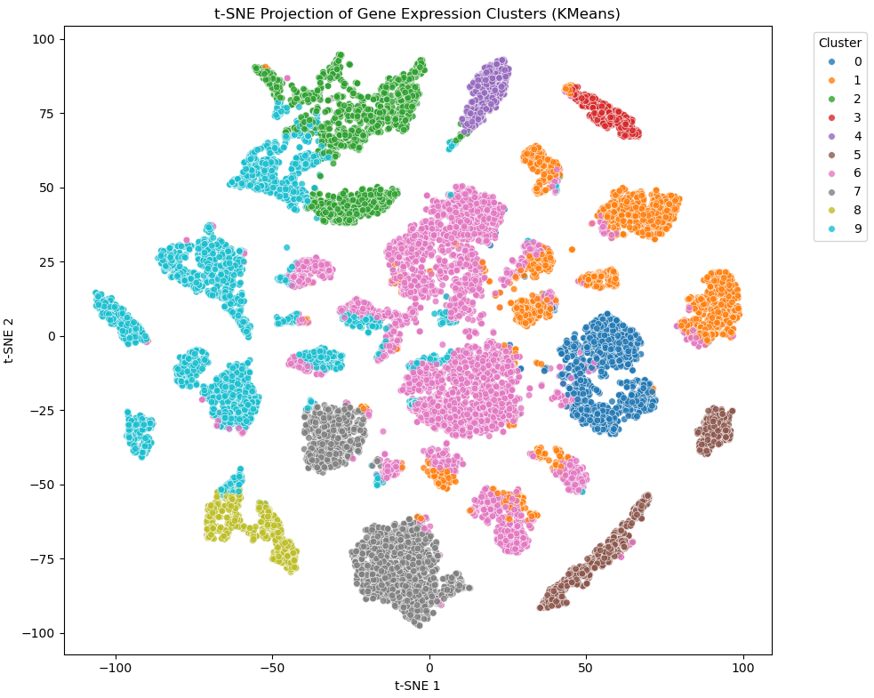
Visual Evidence - UMAP & t-SNE
Both nonlinear dimensionality reduction methods provided clearer visual separability:
UMAP showed well-formed compact clusters.
t-SNE revealed local structures, aiding intuitive cluster interpretation.

Slide 14
Conclusion
The project successfully demonstrated that unsupervised machine learning methods, applied to high-dimensional RNA-seq gene expression data, can differentiate human tissue types with substantial biological validity, without any prior tissue labels.

